Slide 1



Online private Tutor Finder system
Department of Computer Applications
St. Joseph’s College of Engineering & Technology,Palai
Gopika Gopinathan
SJC20MCA-2026
Under the Guidance of:
Mr. Jose George
Asst.Professor
Department of Computer Application

Slide 2

INDEX
Project Introduction
Module Description
Scope of the project
DFD
Table design
Form Design
Conclusion

Slide 3
introduction
The system of private tuition has been in existence in India for a long time but in recent times it has grown in manifold affecting the core of the educational system. This private tutor system will help to find tuition teachers on any subject. Teachers can also get a student just by logging onto the website and setting up the profile.
Parents can filter and select the tutor based on the demo lecture. After attending the lecture, they can book the tutor online and give feedback to the tutor. This system provides the platform for online classes. This private tuition system can help the tutors to get students and parents to find the best tutors for their children.

Slide 4
Module description
The different modules used are the follows:
Admin
Approve Tutor & User Registration
View Tutor details
View User details
Add Subject & standard
View Notes
View Feedback
Assign Tutors

Slide 5
Module description
The different modules used are the follows:
User
View Profile(Update)
View Tutors
View Class details
View Assignments
Upload Assignments
Request Demo Videos
Booking
Add Feedback

Slide 6
Module description
The different modules used are the follows:
Tutors
View Profile(Update)
Add Assignments
Add class schedules
View Bookings
View Demo Request
Add Notes
Upload demo videos
View Feedback

Slide 7
TeCHNOLOGY & TOOLS USED
Front End : PHP
Back End : MySQL

Slide 8
Scope of project
The objective of tutor finder is a tool to assist the students/ parents to find Private Tutor in an interactive manner. It aims to complement the efforts of students to find a desirable teacher. Online tutoring has changed the education scene. A tutor can teach according to his suitable time and from his own place and a student can learn at a time that suits him from his home itself without the hassle of commute. The only thing that both parties require is access to a computer and good internet connection. It also increased the capacity of a tutor, which means a tutor teach many students from different location at the same time .

Slide 9
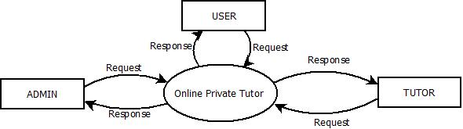
Data flow diagram
Level 0 - DFD

Slide 10
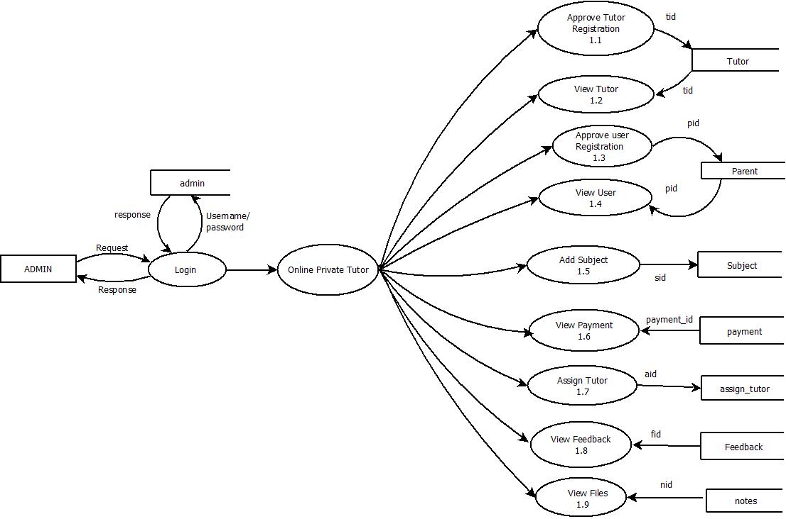
Data flow diagram
Level 1 - Admin

Slide 11
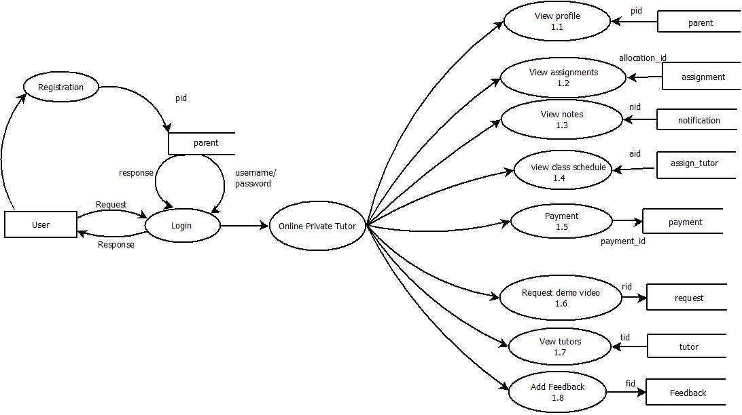
Data flow diagram
Level 1 - User

Slide 12
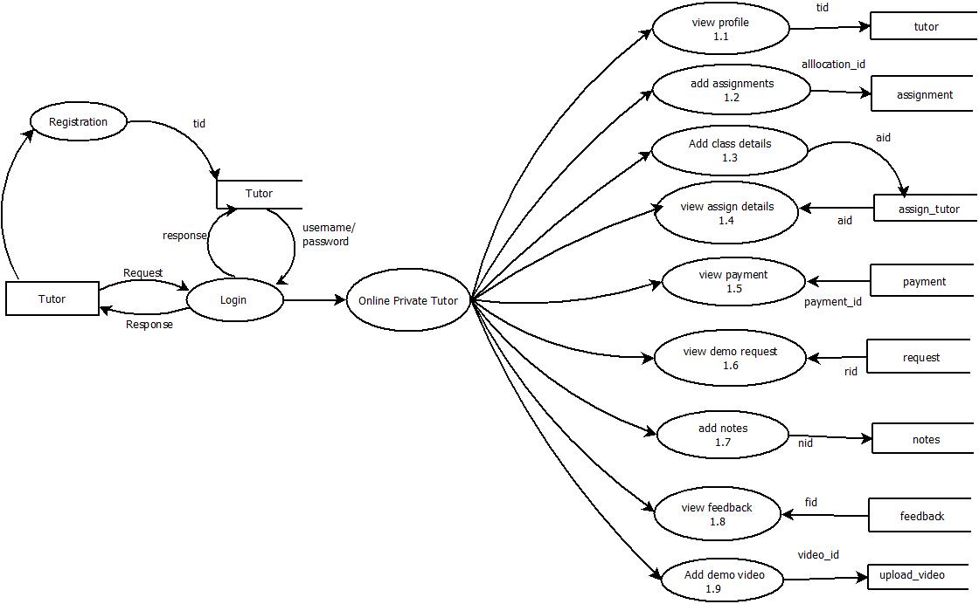
Data flow diagram
Level 1 - Tutor

Slide 13
Table design
Table 1: ADMIN_LOGIN
FIELD NAME | DATA TYPE | CONSTRAINT | DESCRIPTON
admin_Id | Int (11) | Primary Key | Login id
Email | Varchar(50) | Not Null | Email
Password | Varchar(50) | Not Null | Password
Name | Varchar(50) | Not Null | Name

Slide 14
Table design
Table 2: TUTOR_REGISTRATION
FIELDNAME | DATATYPE | CONSTRAINT | DESCRIPTION
tid | int(11) | Primary Key | Tutor id
name | Varchar(50) | Not Null | Tutor Name
email | Varchar(100) | Not Null | Tutor Email id
password | Varchar(50) | Not Null | Password
address | Varchar(250) | Not Null | Tutor’s address
phone | Varchar(50) | Not Null | Phone Number
qualification | Varchar(50) | Not Null | Qualification

Slide 15
Table design
Table 2: TUTOR_REGISTRATION
FIELDNAME | DATATYPE | CONSTRAINT | DESCRIPTION
experience | Varchar(50) | Not Null | Experience
stream | Varchar(50) | Not Null | Stream
subject | Varchar(50) | Not Null | Subject
image | tinytext | Not Null | Image
gender | Varchar(50) | Not Null | Gender
status | Varchar(50) | Not Null | Status
rate | Varchar(50) | Not Null | Rate

Slide 16
Table design
Table 3: USER_REGISTRATION
FIELDNAME | DATATYPE | CONSTRAINT | DESCRIPTION
pid | int(11) | Primary Key | Parent id
name | Varchar(50) | Not Null | Parent Name
email | Varchar(100) | Not Null | Parent Email id
password | Varchar(50) | Not Null | Password
address | Varchar(250) | Not Null | Parent address
phone | Varchar(50) | Not Null | Phone Number

Slide 17
Table design
Table 3: USER_REGISTRATION
FIELDNAME | DATATYPE | CONSTRAINT | DESCRIPTION
childname | Varchar(50) | Not Null | Childname
standard | Varchar(50) | Not Null | Standard
stream | Varchar(50) | Not Null | Stream
status | Varchar(50) | Not Null | Status
gender | Varchar(50) | Not Null | Gender
childname | Varchar(50) | Not Null | Child Name

Slide 18
Table design
Table 4: ASSIGN_TUTOR
FIELDNAME | DATATYPE | CONSTRAINT | DESCRIPTION
aid | int(11) | Primary Key | Assign id
tid | int(11) | Foreign Key | Tutor Id
tutor_name | Varchar(100) | Not Null | Tutor Name
subject | Varchar(50) | Not Null | Subject
stream | Varchar(250) | Not Null | Stream
qualification | Varchar(50) | Not Null | Qualification

Slide 19
Table design
Table 4: ASSIGN_TUTOR
FIELDNAME | DATATYPE | CONSTRAINT | DESCRIPTION
Start_time | time(6) | Not Null | Start_time
end_time | time(6) | Not Null | End_time
class_date | date | Not Null | Class_date
link | Varchar(250) | Not Null | Link
meeting_no | BigInt(30) | Not Null | Meeting_no
Meeting_pswd | Varchar(250) | Not Null | Password

Slide 20
Table design
Table 5: ADD_SUBJECT
FIELDNAME | DATATYPE | CONSTRAINT | DESCRIPTION
sid | Int(11) | Primary Key | Subject id
subject | Varchar(50) | Not Null | Subject
standard | Varchar(50) | Not Null | Standard

Slide 21
Table design
Table 6: REQUEST
FIELDNAME | DATATYPE | CONSTRAINT | DESCRIPTION
rid | Int(11) | Primary Key | Request id
tid | Int(11) | Foreign Key | Tutor id
pid | Int(11) | Foreign Key | Parent id
subject | Varchar(50) | Not Null | Subject
standard | Varchar(50) | Not Null | Standard
childname | Varchar(50) | Not Null | Child Name
status | Varchar(50) | Not Null | Status
request_date | date | Not Null | Request date

Slide 22
Table design
Table 8: NOTES
FIELDNAME | DATATYPE | CONSTRAINT | DESCRIPTION
video_id | Int(11) | Primary Key | Video id
video_id | Int(11) | Primary Key | Video id
tid | Int(11) | Foreign Key | Tutor id
name | Varchar(250) | Not Null | Video Name
FIELDNAME | DATATYPE | CONSTRAINT | DESCRIPTION
nid | Int(11) | Primary Key | Notes id
tid | Int(11) | Foreign Key | Tutor id
subject | Varchar(50) | Not Null | Subject
notes | Varchar(250) | Not Null | Notes
file _type | Varchar(50) | Not Null | File Type
standard | Varchar(50) | Not Null | Standard

Slide 23
Table design
Table 9: ASSIGNMENT
FIELDNAME | DATATYPE | CONSTRAINT | DESCRIPTION
video_id | Int(11) | Primary Key | Video id
video_id | Int(11) | Primary Key | Video id
tid | Int(11) | Foreign Key | Tutor id
name | Varchar(250) | Not Null | Video Name
FIELDNAME | DATATYPE | CONSTRAINT | DESCRIPTION
allocation_id | Int(11) | Primary Key | Notes id
tid | Int(11) | Foreign Key | Tutor id
pid | Int(11) | Foreign Key | Parent id
subject | Varchar(250) | Not Null | Subject
standard | Varchar(50) | Not Null | Standard
pdate | Varchar(50) | Not Null | Upload date
sdate | Varchar(50) | Not Null | Submission date
uploadfile | Varchar(250) | Not Null | Assignment
assignment | Varchar(250) | Not Null | Uploaded assignment

Slide 24
Table design
Table 10: PAYMENT
FIELDNAME | DATATYPE | CONSTRAINT | DESCRIPTION
video_id | Int(11) | Primary Key | Video id
video_id | Int(11) | Primary Key | Video id
tid | Int(11) | Foreign Key | Tutor id
name | Varchar(250) | Not Null | Video Name
FIELDNAME | DATATYPE | CONSTRAINT | DESCRIPTION
payment_id | Int(11) | Primary Key | Payment id
tid | Int(11) | Foreign Key | Tutor id
pid | Int(11) | Foreign Key | Parent id
name | Varchar(50) | Not Null | Child Name
amount | Int(11) | Not Null | Amount
pay_id | Varchar(250) | Not Null | Pay Id
pay_status | Varchar(50) | Not Null | Payment Status
date_added | datetime | Not Null | Date
parent_name | Varchar(50) | Not Null | Parent Name
tutor_name | Varchar(50) | Not Null | Tutor Name

Slide 25
Table design
Table 11: FEEDBACK
FIELDNAME | DATATYPE | CONSTRAINT | DESCRIPTION
video_id | Int(11) | Primary Key | Video id
video_id | Int(11) | Primary Key | Video id
tid | Int(11) | Foreign Key | Tutor id
name | Varchar(250) | Not Null | Video Name
FIELDNAME | DATATYPE | CONSTRAINT | DESCRIPTION
fid | Int(11) | Primary Key | Payment id
tid | Int(11) | Foreign Key | Tutor id
pid | Int(11) | Foreign Key | Parent id
parent_name | Varchar(50) | Not Null | Parent Name
subject | Varchar(50) | Not Null | Subject
standard | Varchar(50) | Not Null | Standard
childname | Varchar(50) | Not Null | Child Name
tutor_name | Varchar(50) | Not Null | Tutor Name
feedback | Varchar(250) | Not Null | Feedback

Slide 26
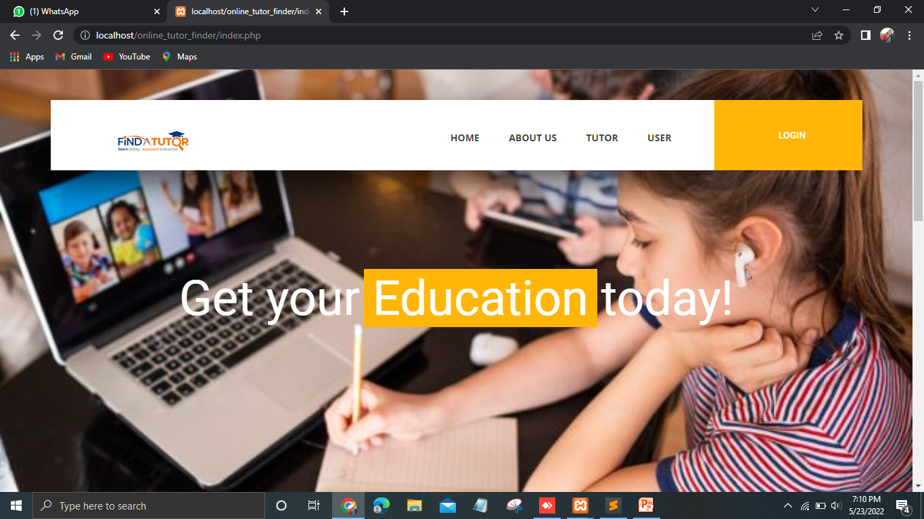
Form design
Home Page

Slide 27
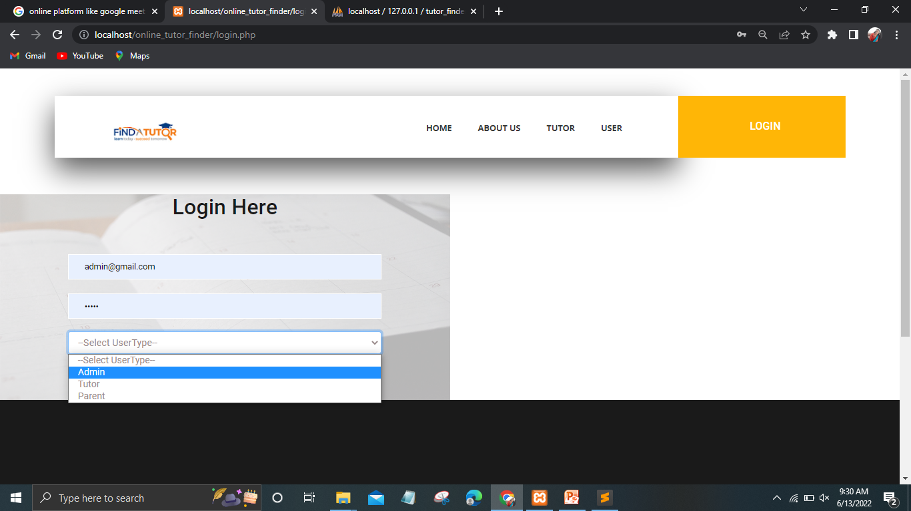
Form design
Login Page

Slide 28
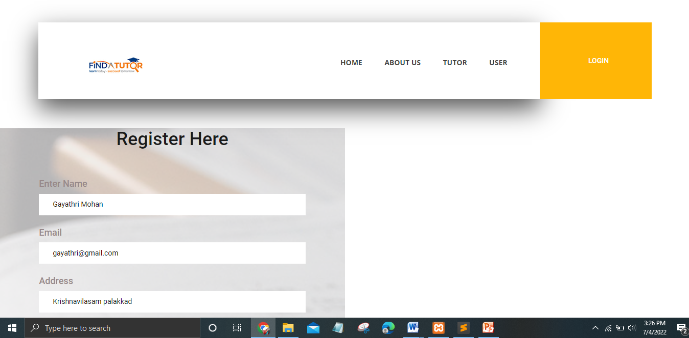
Form design
Tutor Registration Page

Slide 29
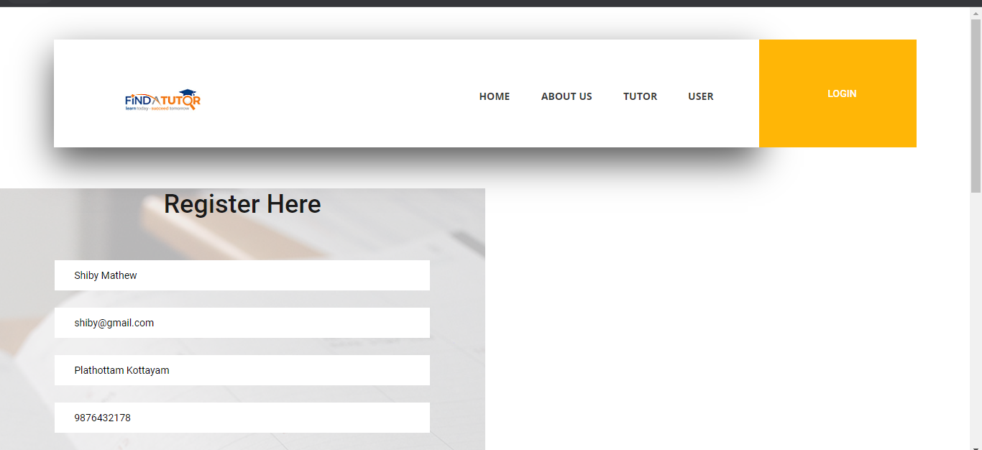
Form design
User Registration Page

Slide 30
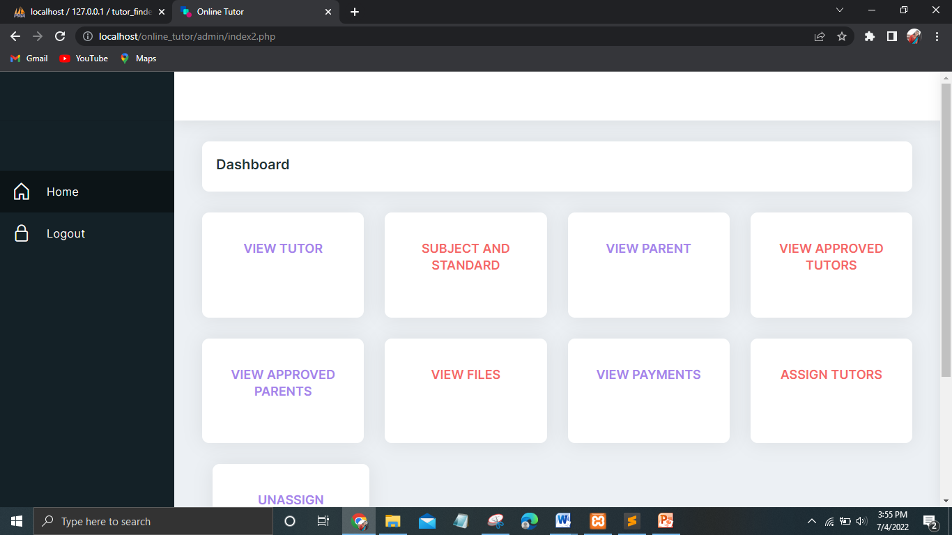
Form design
Admin-Home Page

Slide 31
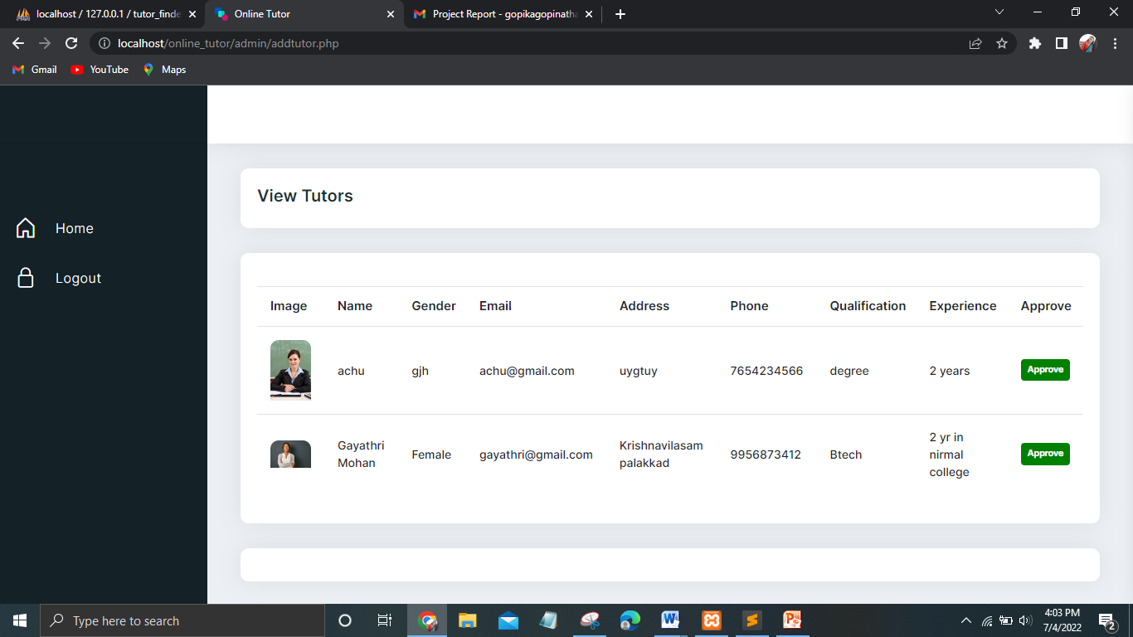
Form design
Admin-View details page-Registered tutors

Slide 32
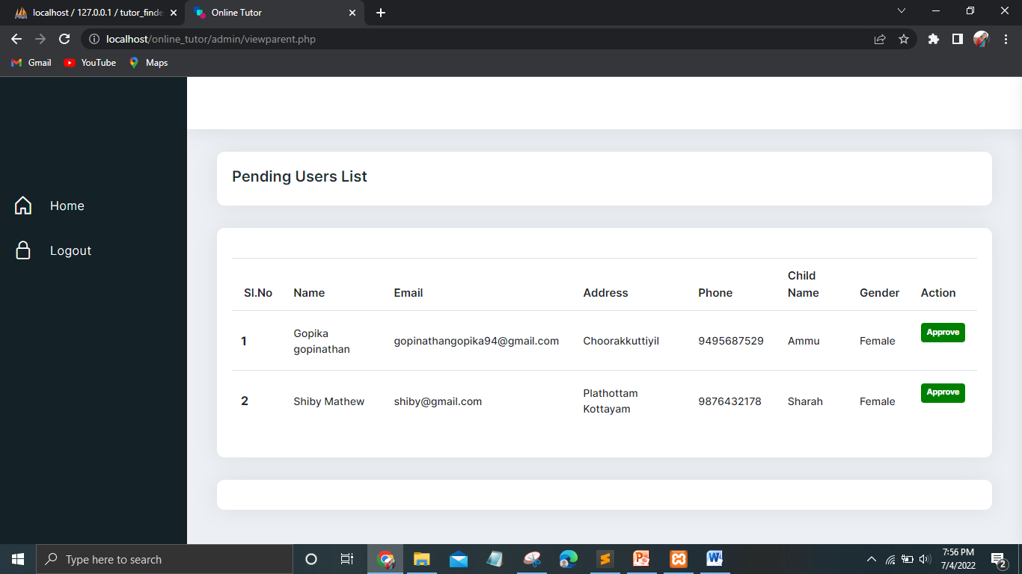
Form design
Admin-View details page-Registered Users

Slide 33
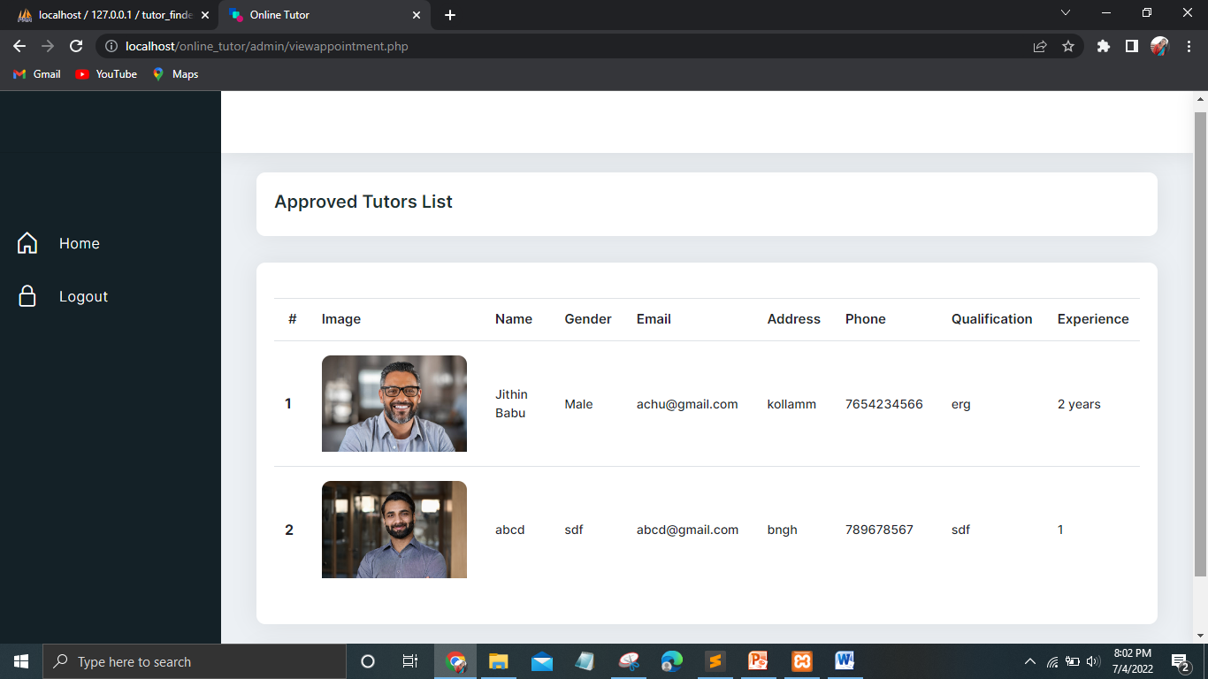
Form design
Admin-View Approved Tutors List

Slide 34
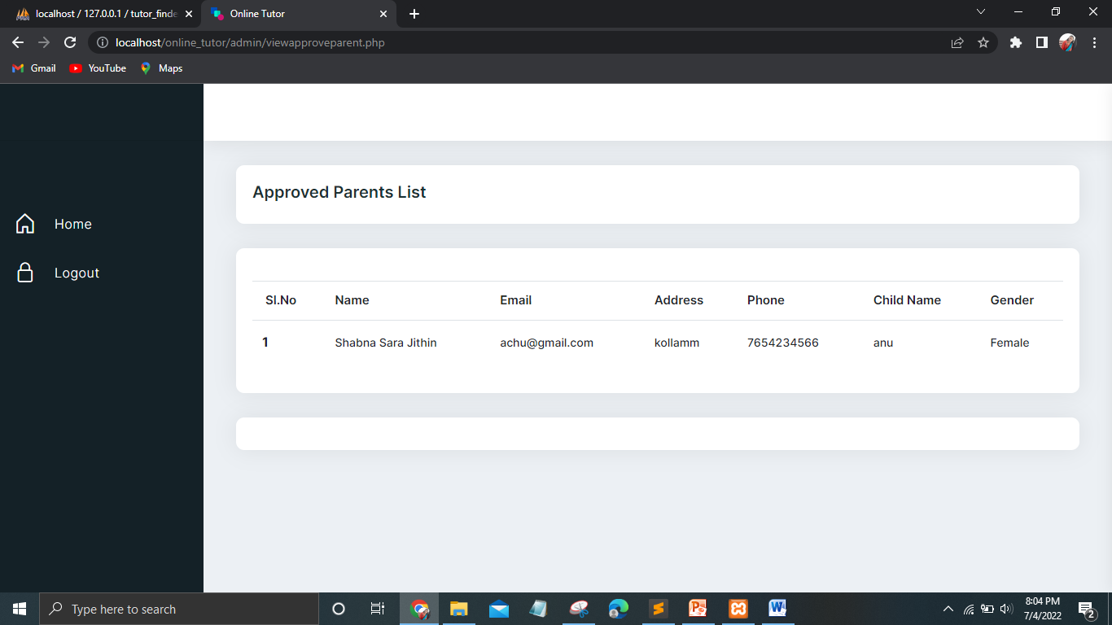
Form design
VIEW APPROVED PARENT LIST

Slide 35
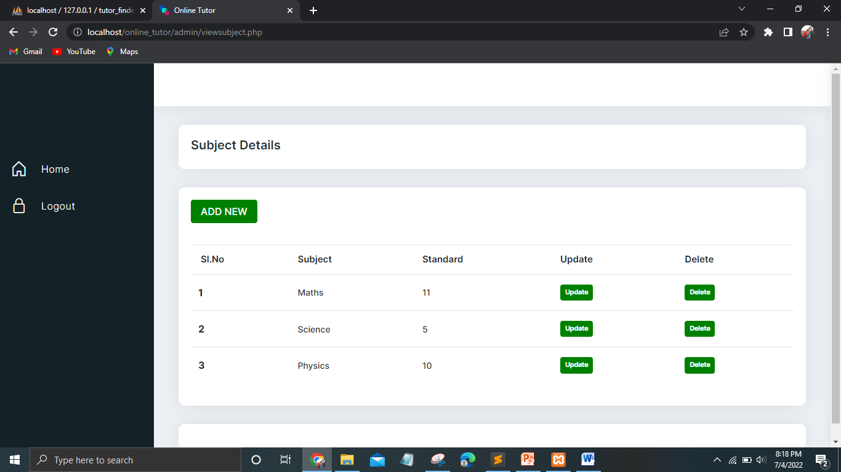
Form design
ADD SUBJECTS

Slide 36
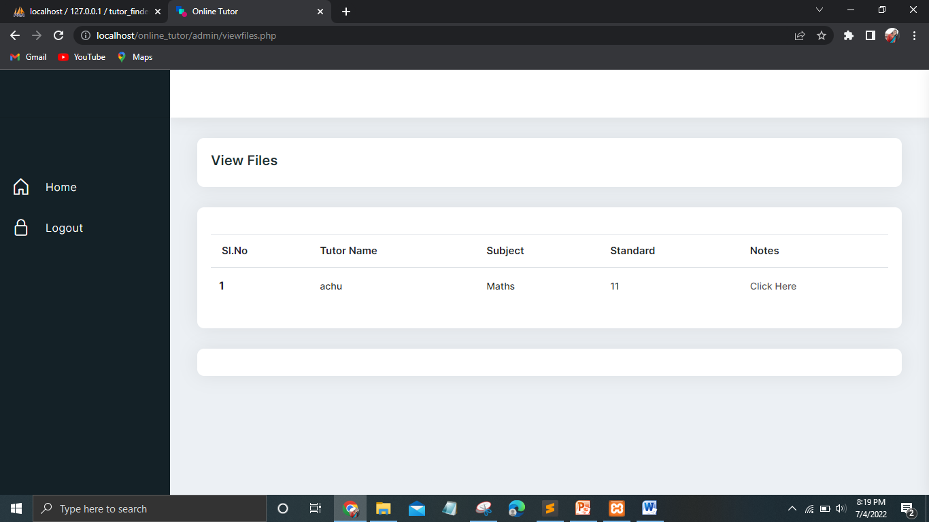
Form design
Admin- VIEW FILES

Slide 37
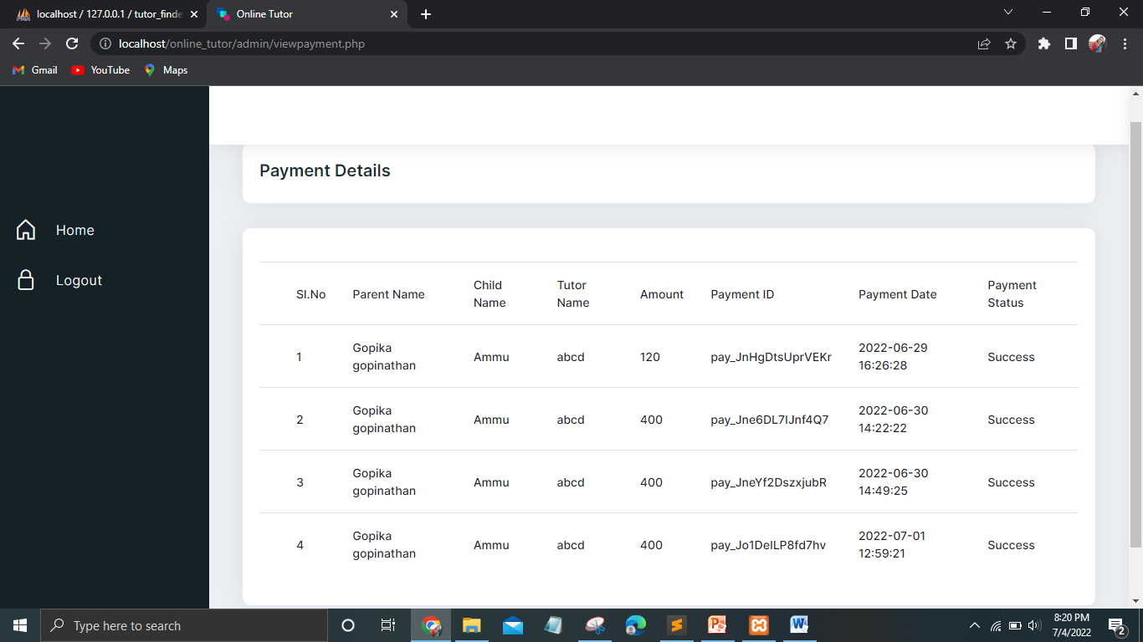
Form design
Admin-VIEW PAYMENT DETAILS

Slide 38
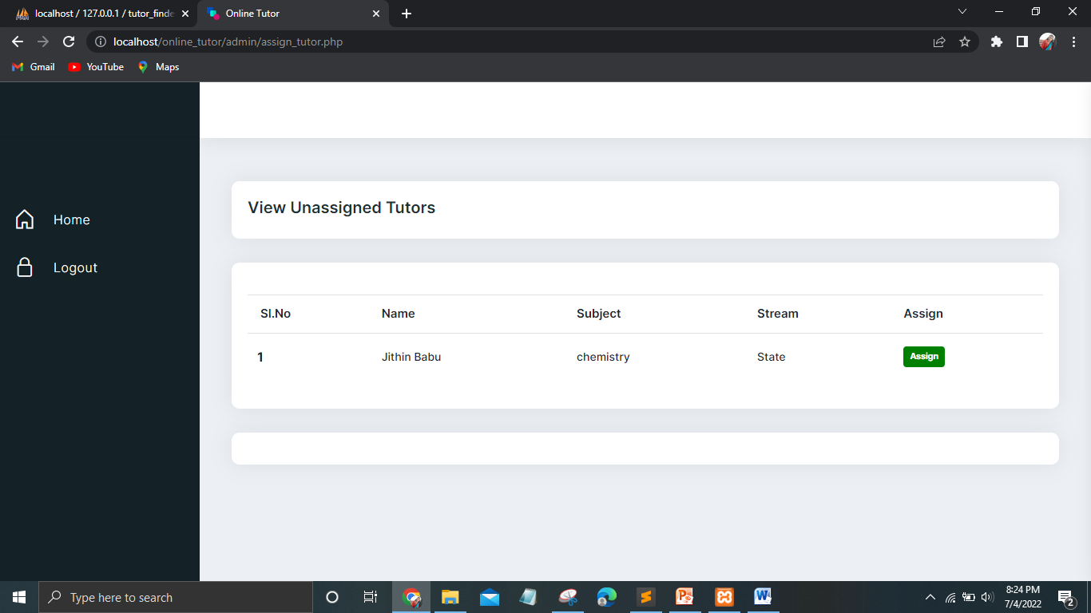
Form design
ADMIN-ASSIGN TUTOR PAGE

Slide 39
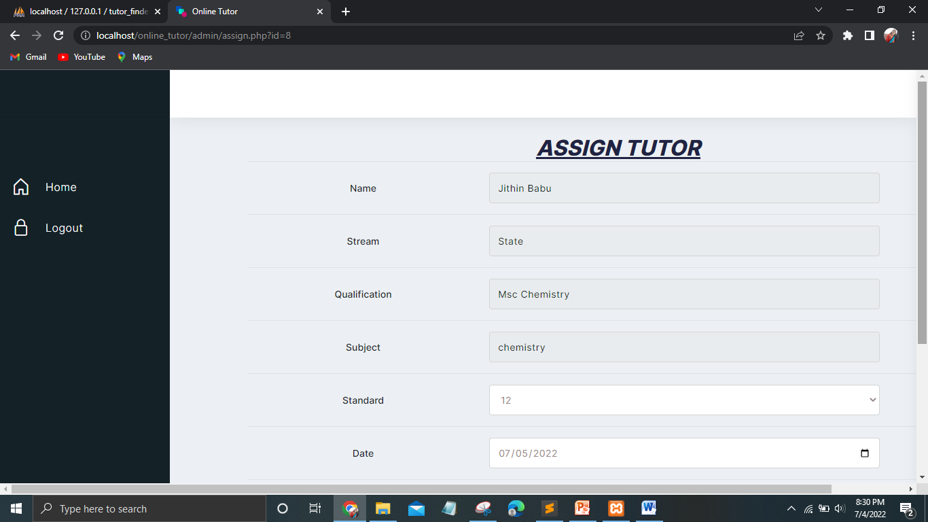
Form design
ADMIN-ASSIGN TUTOR PAGE

Slide 40
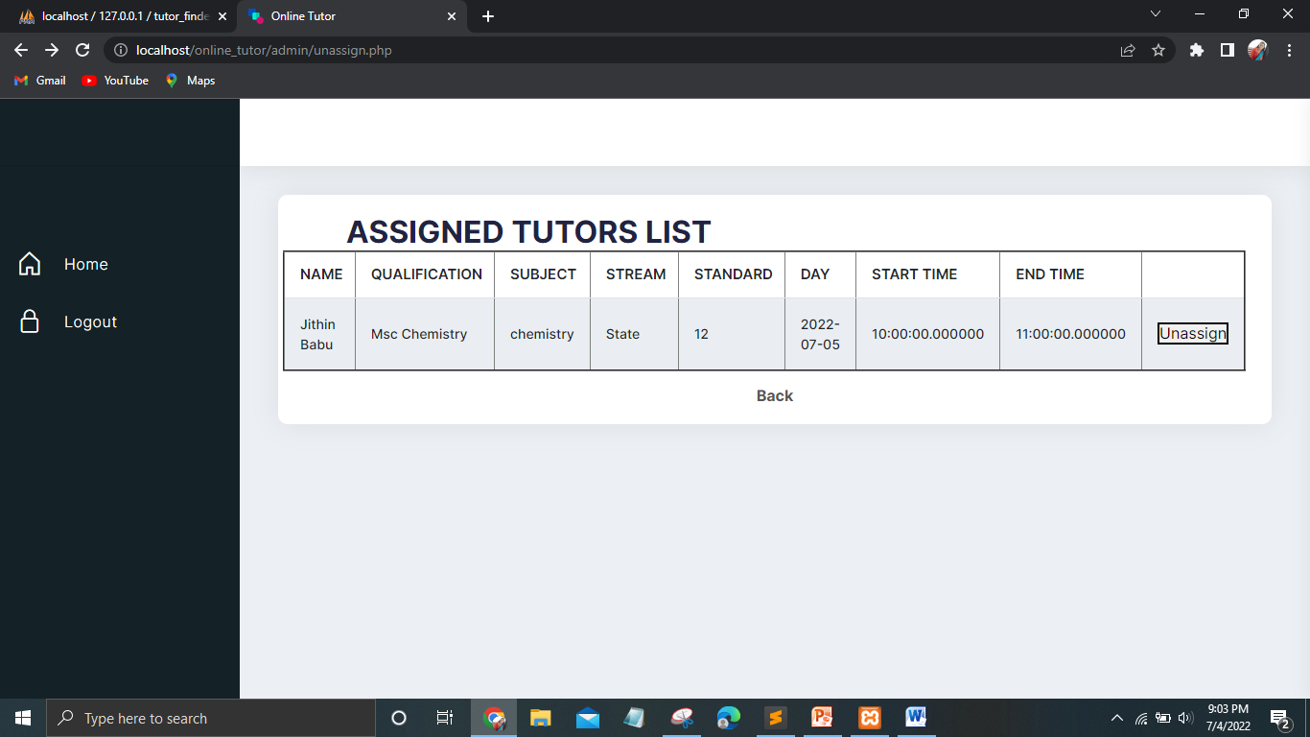
Form design
ADMIN-UNASSIGNED LIST

Slide 41
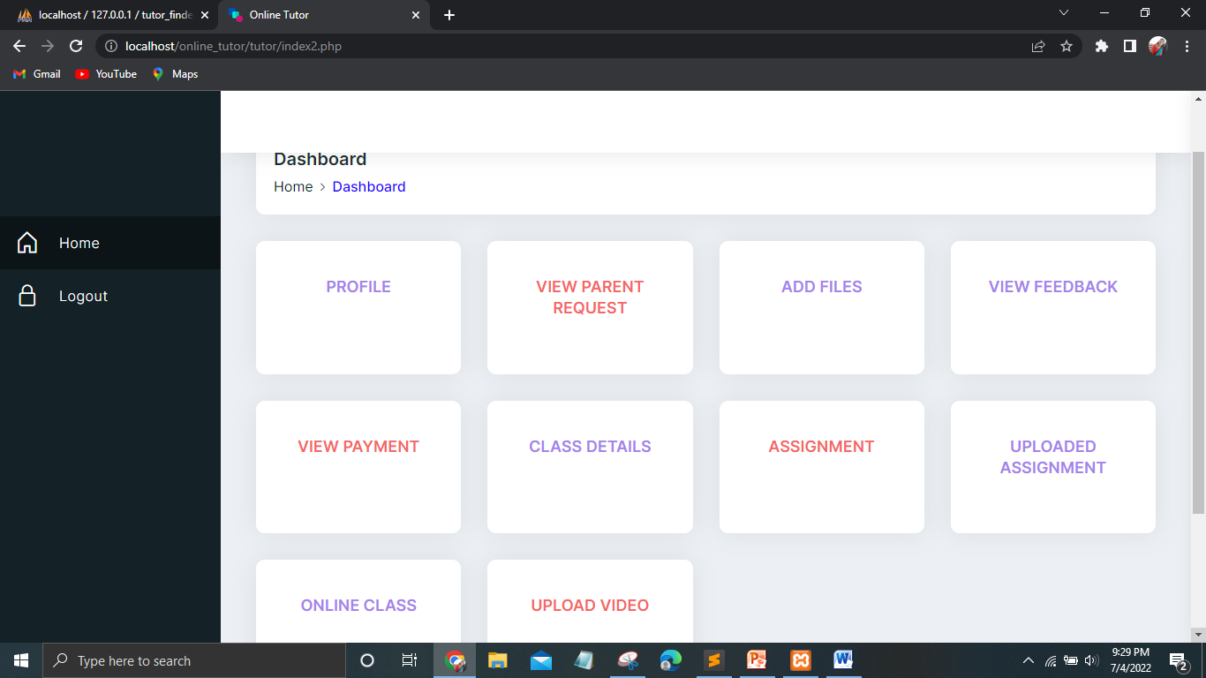
Form design
TUTOR-HOME PAGE

Slide 42
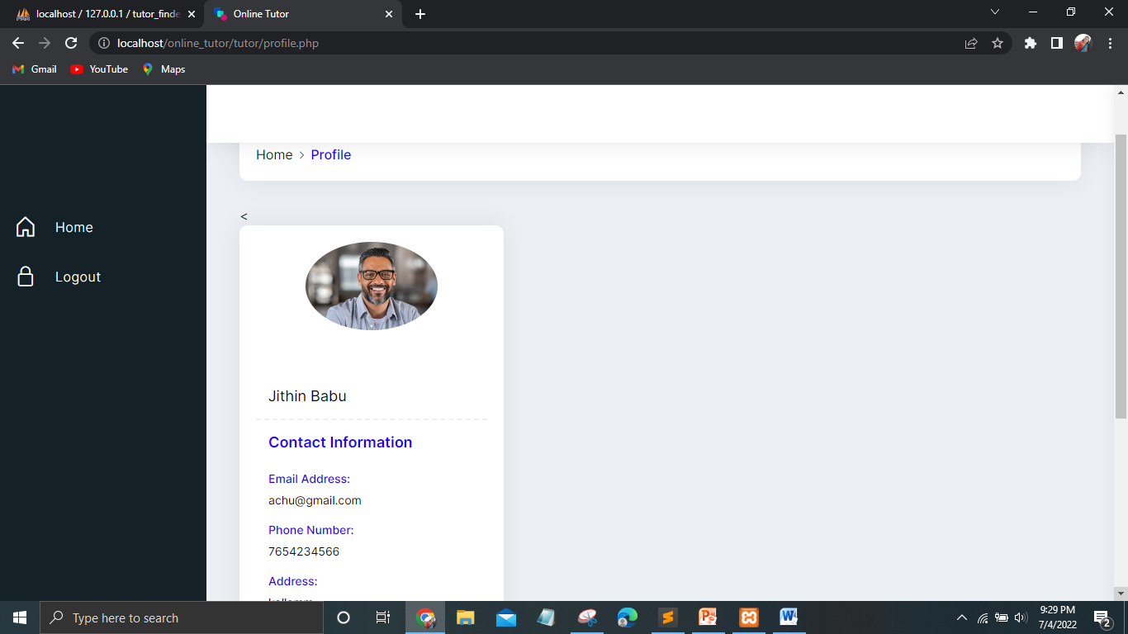
Form design
TUTOR-PROFILE

Slide 43
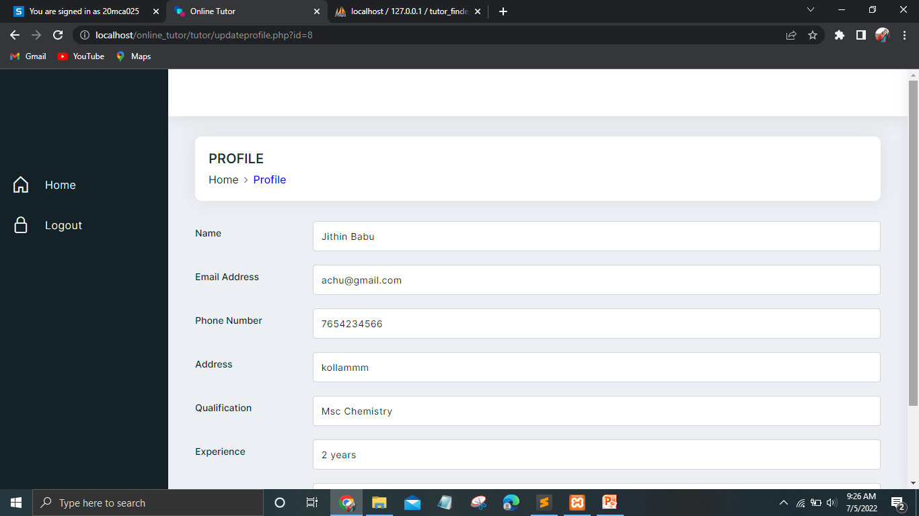
Form design
TUTOR-PROFILE UPDATION

Slide 44
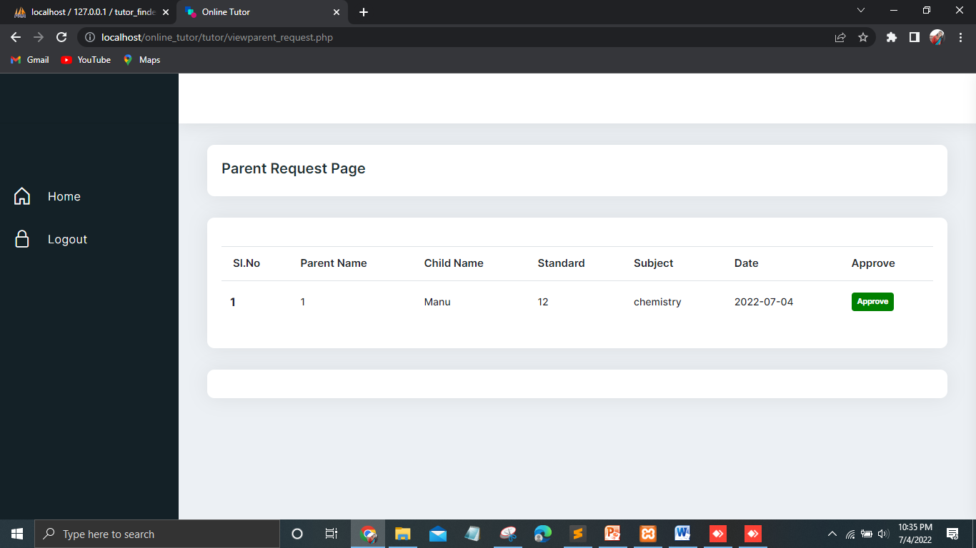
Form design
TUTOR-PARENT REQUEST PAGE

Slide 45
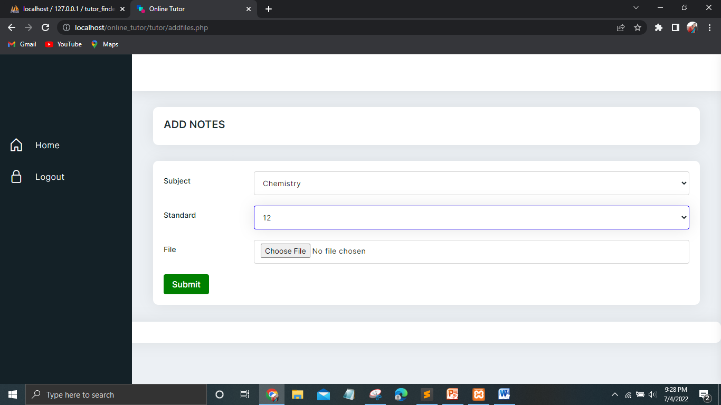
Form design
TUTOR-ADDING NOTES

Slide 46
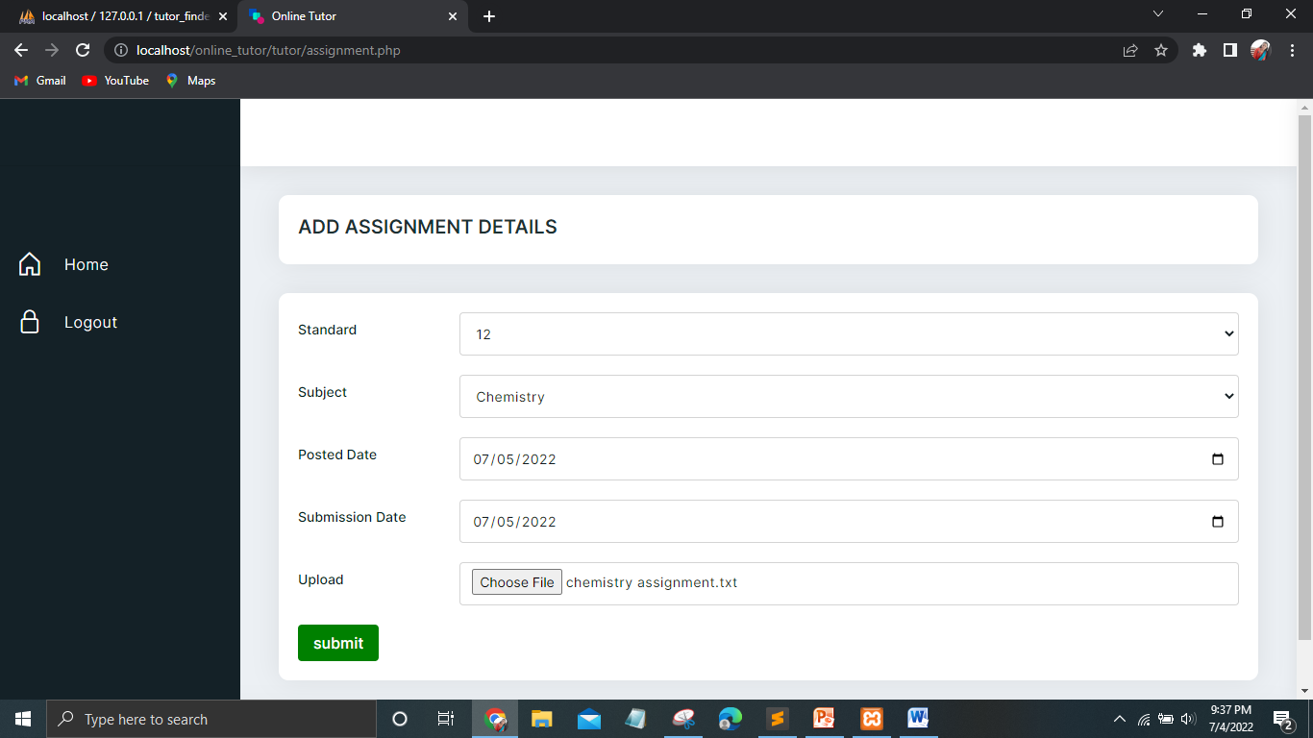
Form design
TUTOR-ADDING ASSIGNMENT

Slide 47
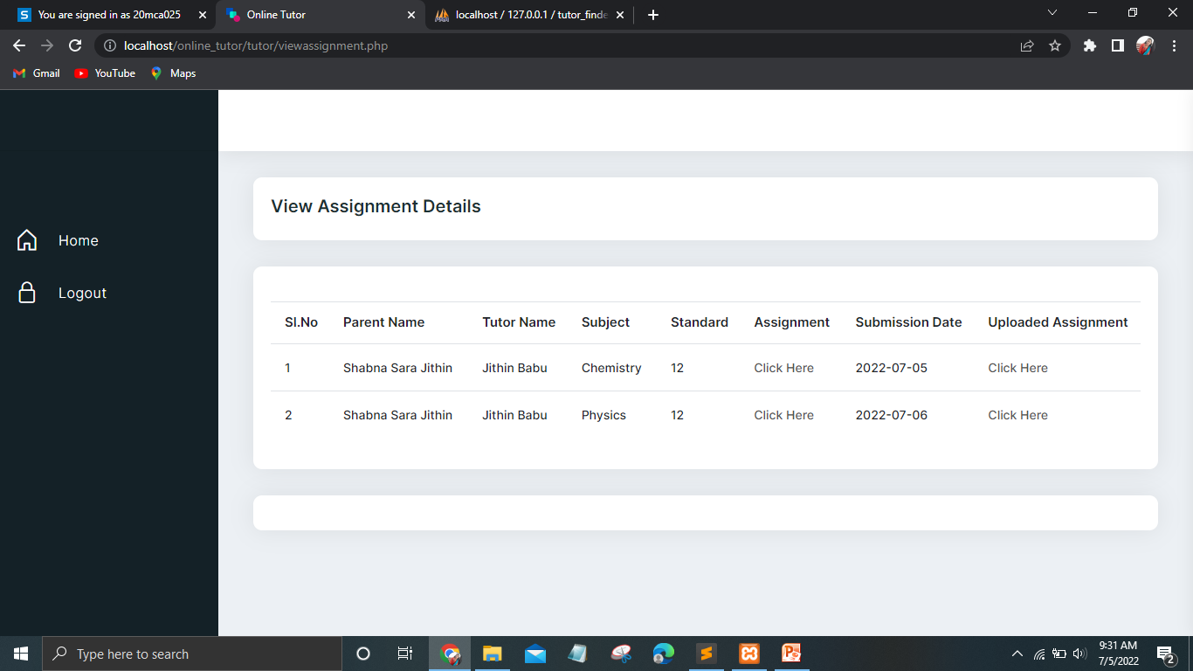
Form design
TUTOR-UPLOADED ASSIGNMENT

Slide 48
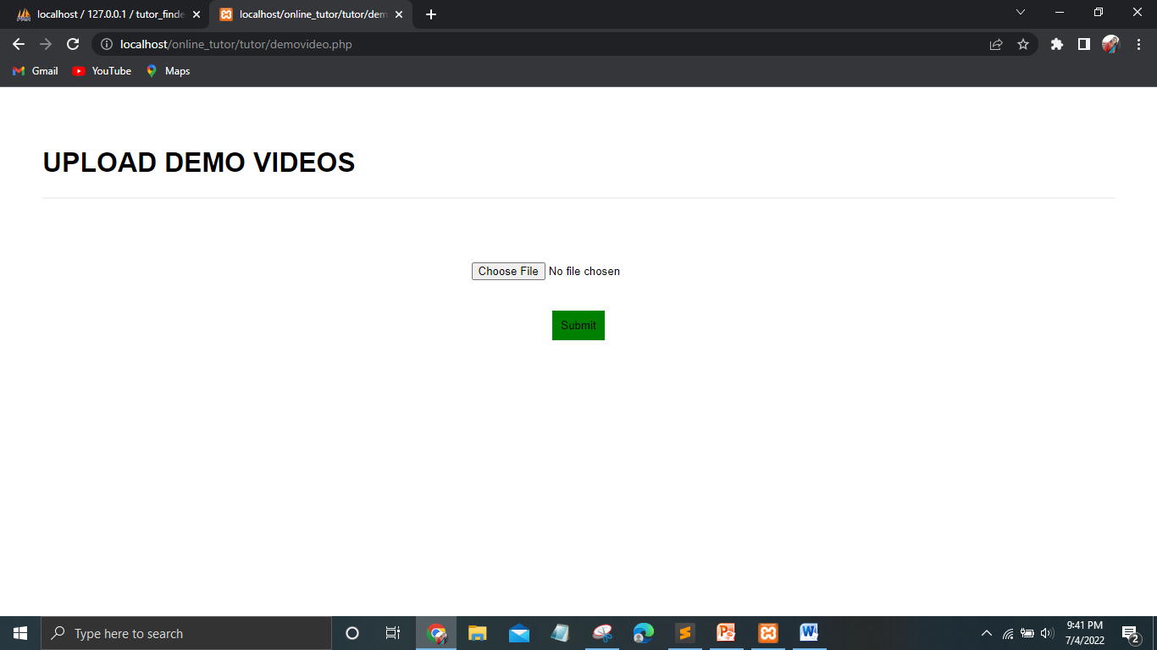
Form design
TUTOR-UPLOAD DEMO VIDEOS

Slide 49
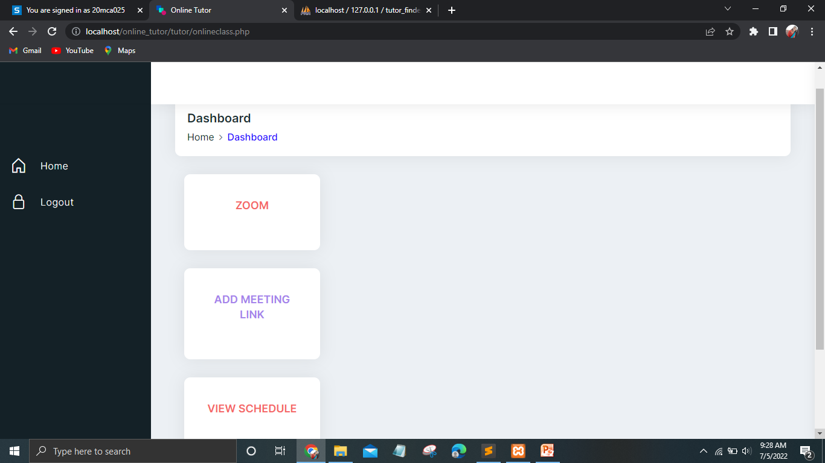
Form design
TUTOR-ONLINE CLASS

Slide 50
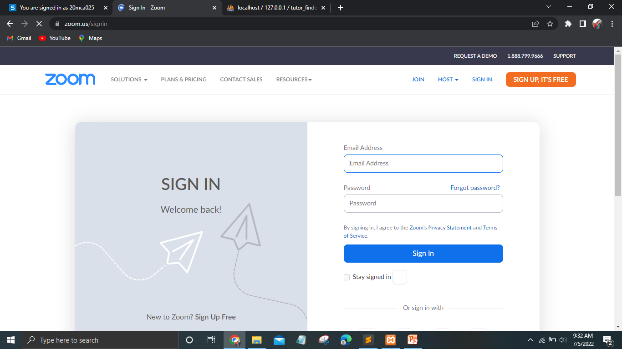
Form design
TUTOR-ONLINE CLASS

Slide 51
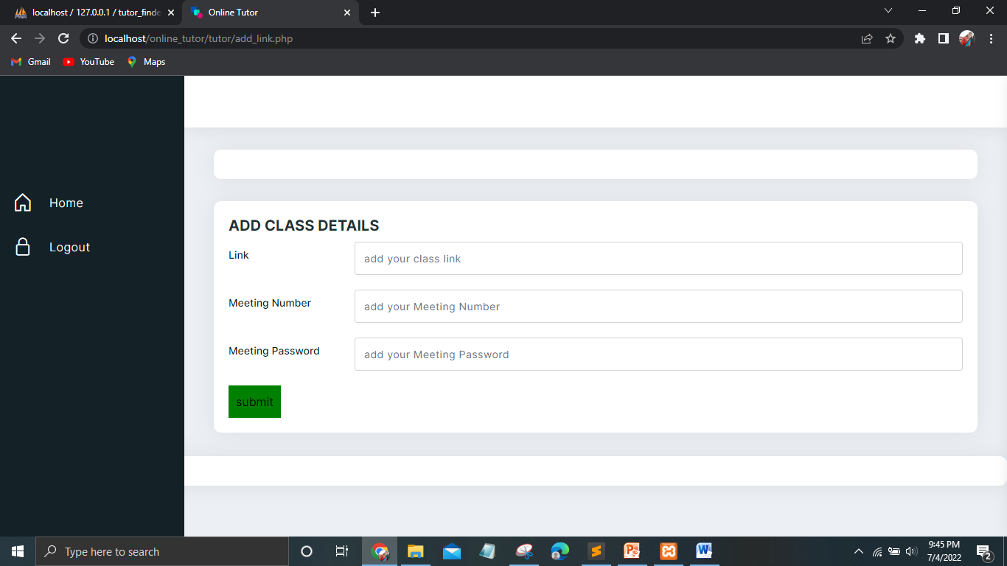
Form design
TUTOR-ADD CLASS DETAILS

Slide 52
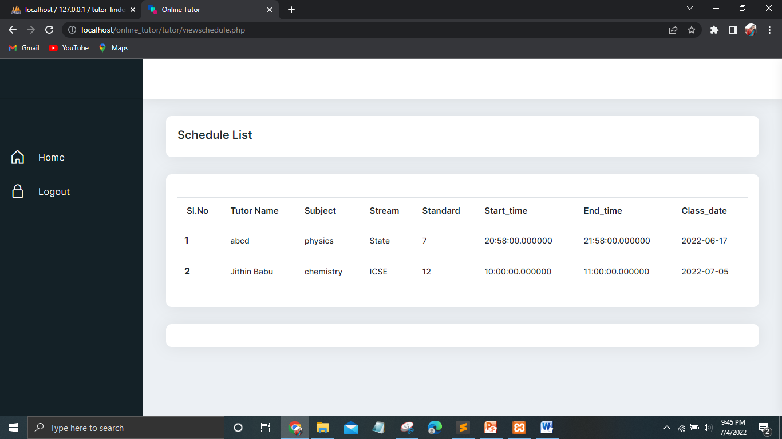
Form design
TUTOR-VIEW SCHEDULE LIST

Slide 53

Form design
TUTOR-VIEW FEEDBACK

Slide 54

Form design
USER-HOME PAGE

Slide 55
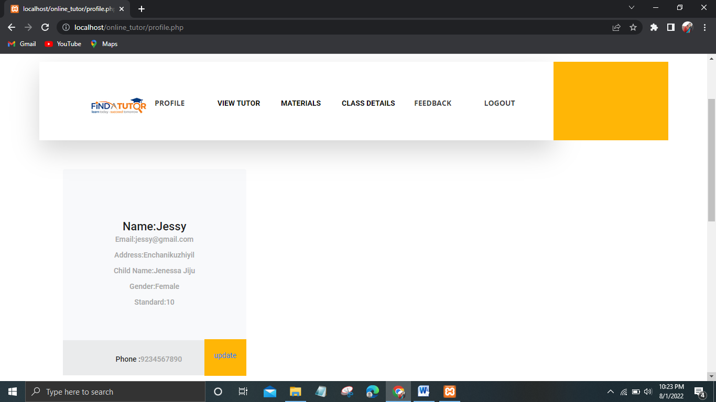
Form design
USER-PROFILE PAGE

Slide 56
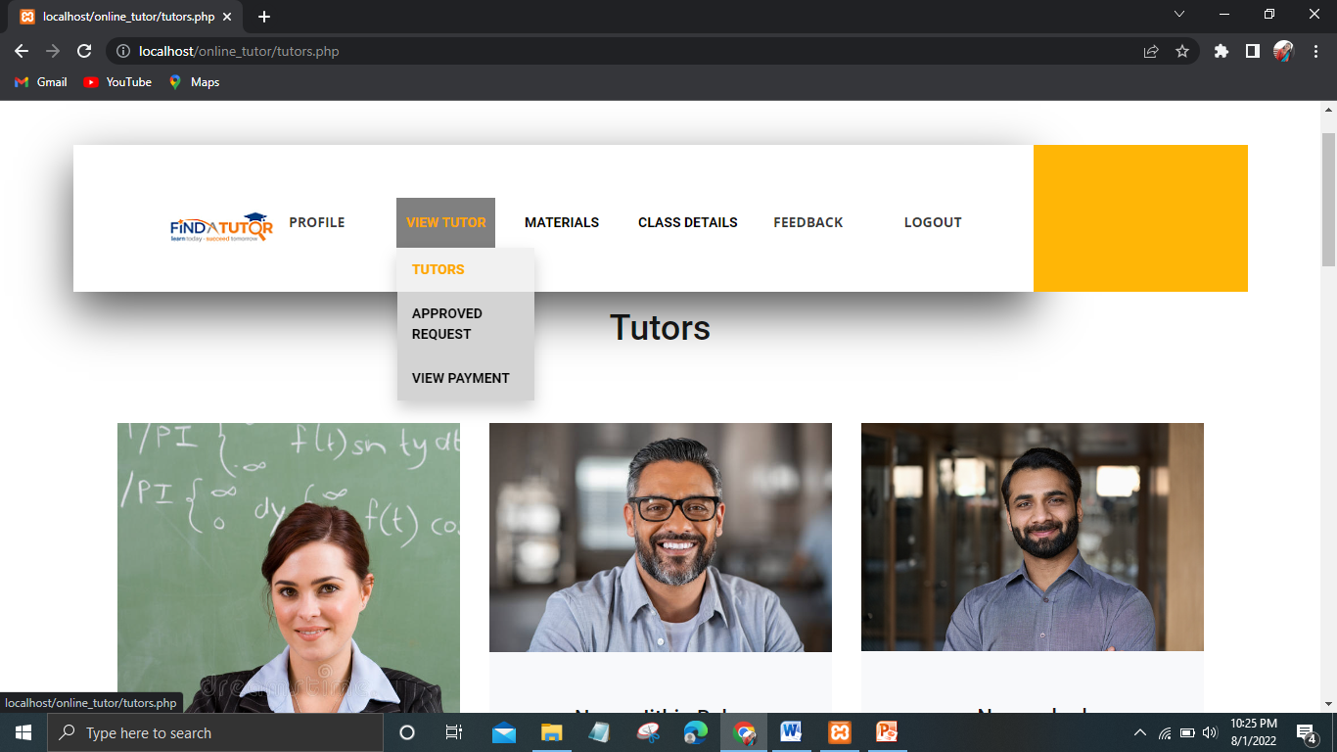
Form design
USER-VIEW TUTORS

Slide 57
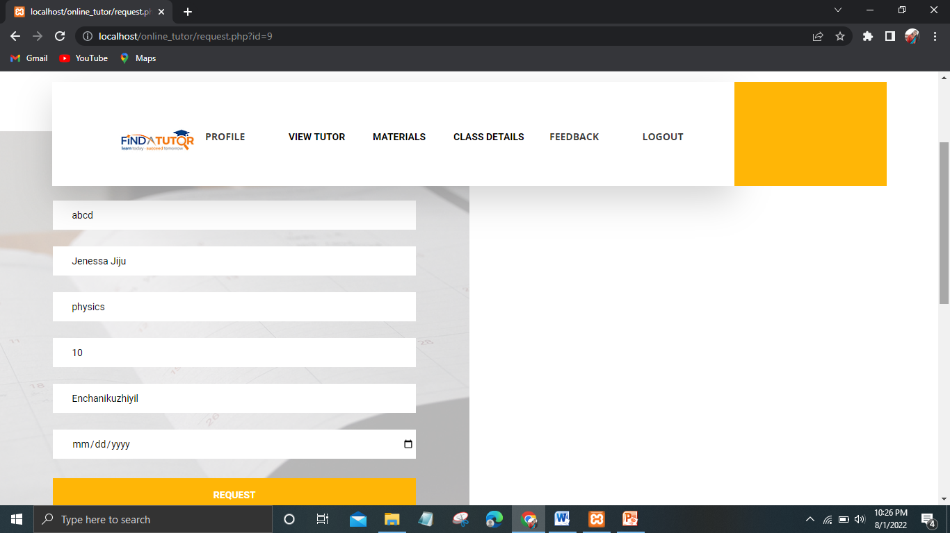
Form design
USER-REQUEST DEMO VIDEOS

Slide 58
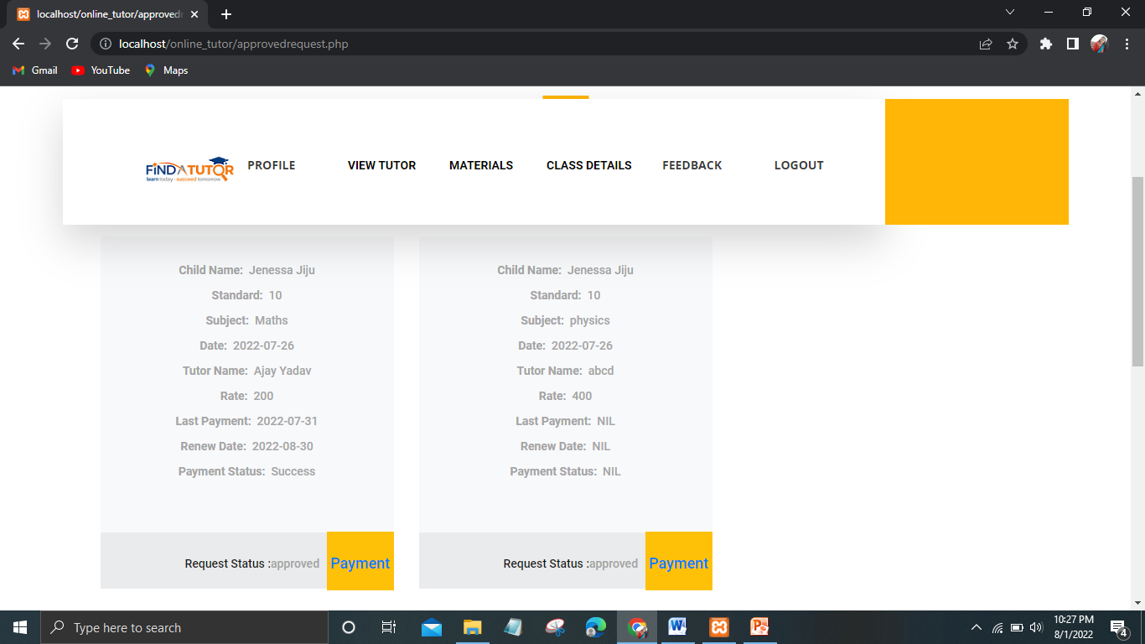
Form design
USER-VIEW APPROVED REQUEST PAGE

Slide 59
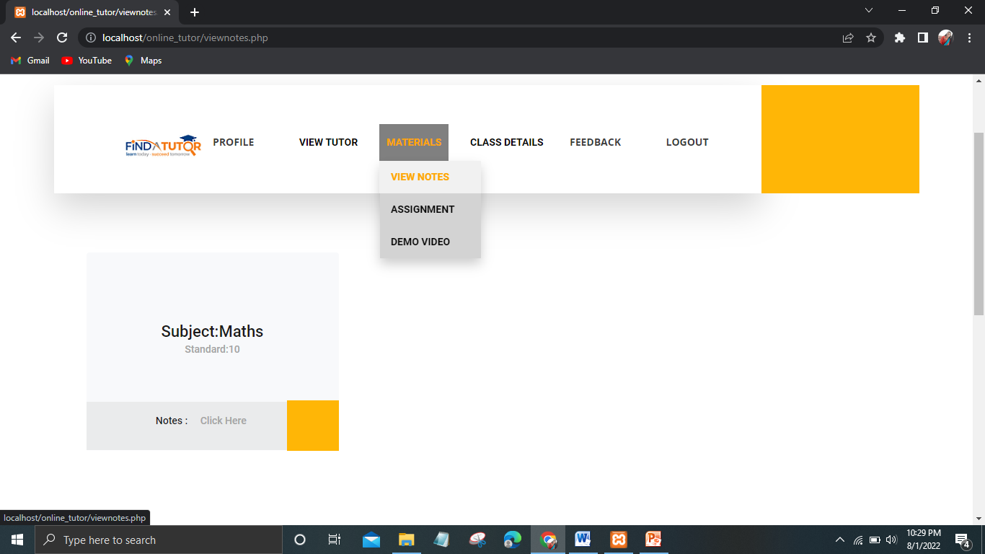
Form design
USER-VIEW NOTES

Slide 60
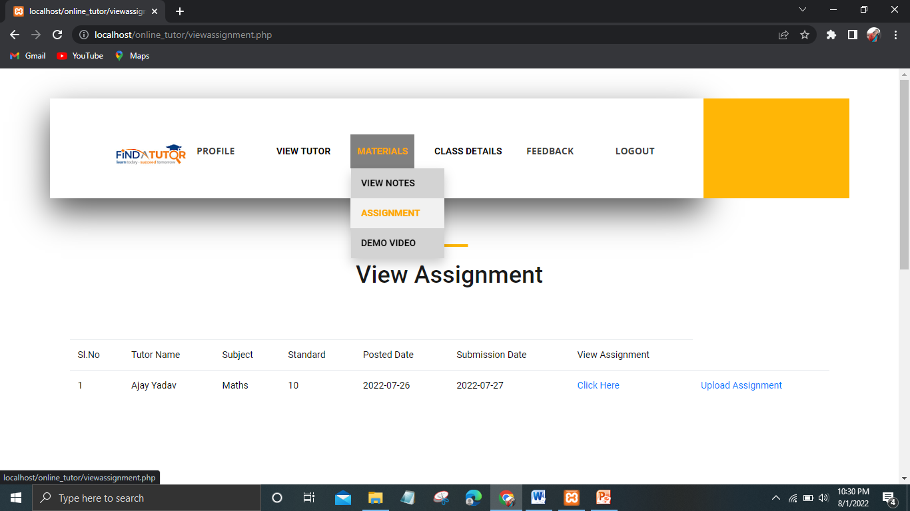
Form design
USER-VIEW ASSIGNMENT

Slide 61
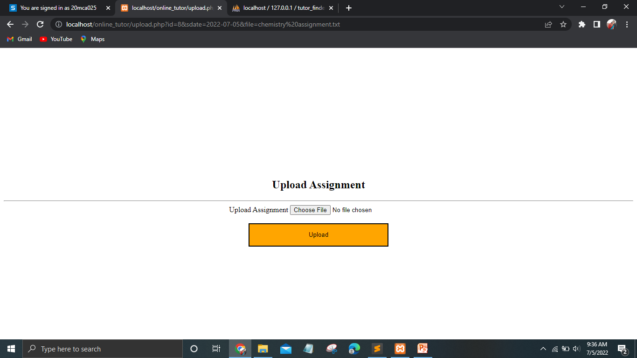
Form design
USER-UPLOAD ASSIGNMENT

Slide 62
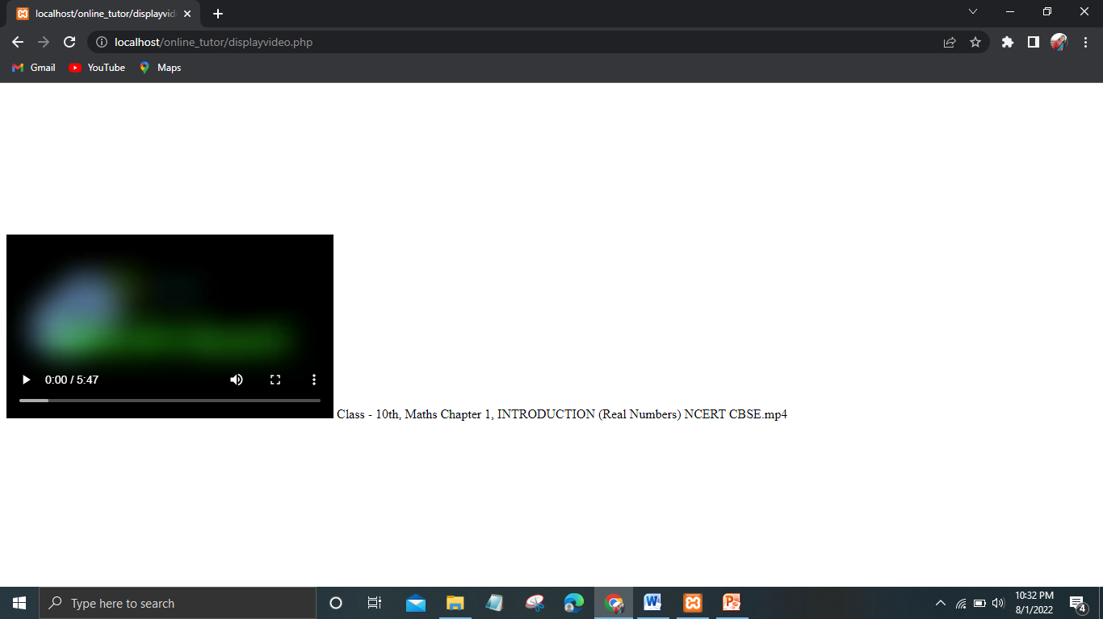
Form design
USER-DEMO VIDEOS

Slide 63
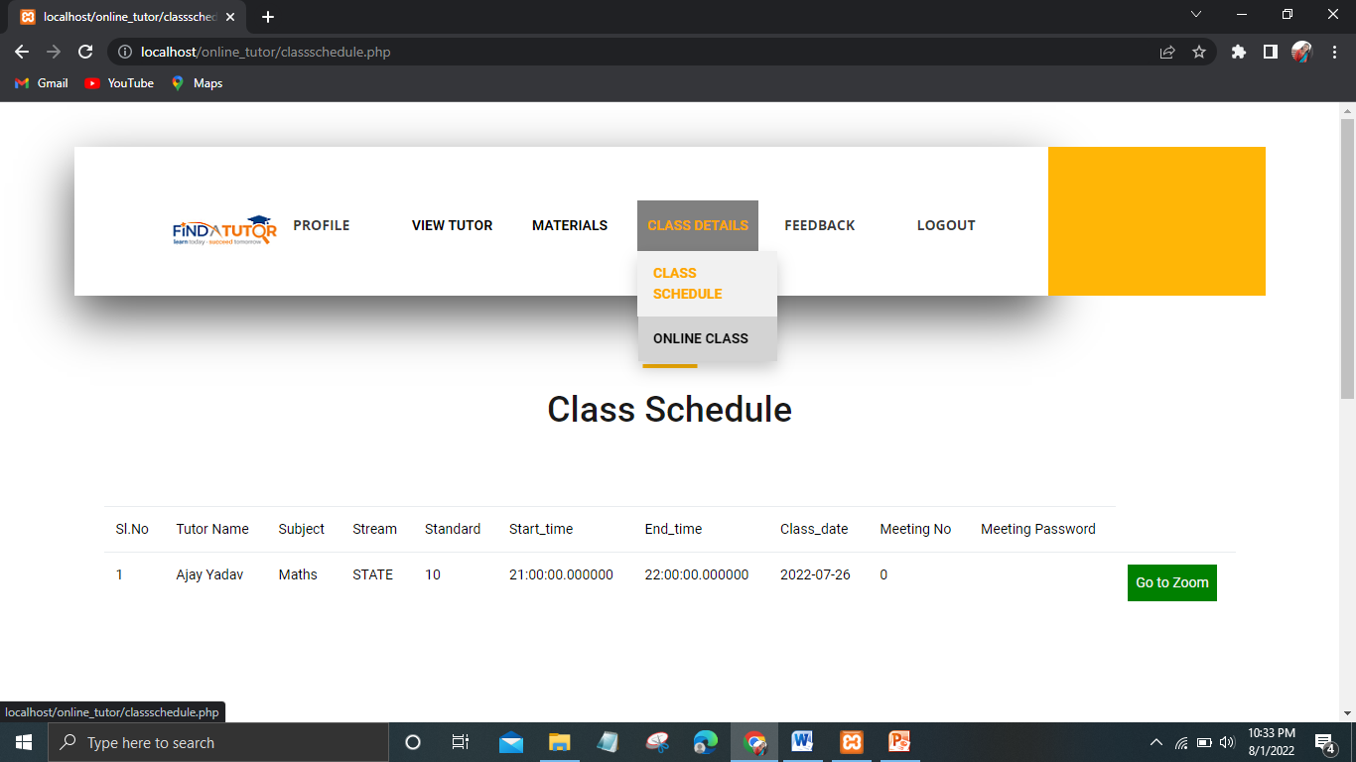
Form design
USER-VIEW CLASS SCHEDULES

Slide 64
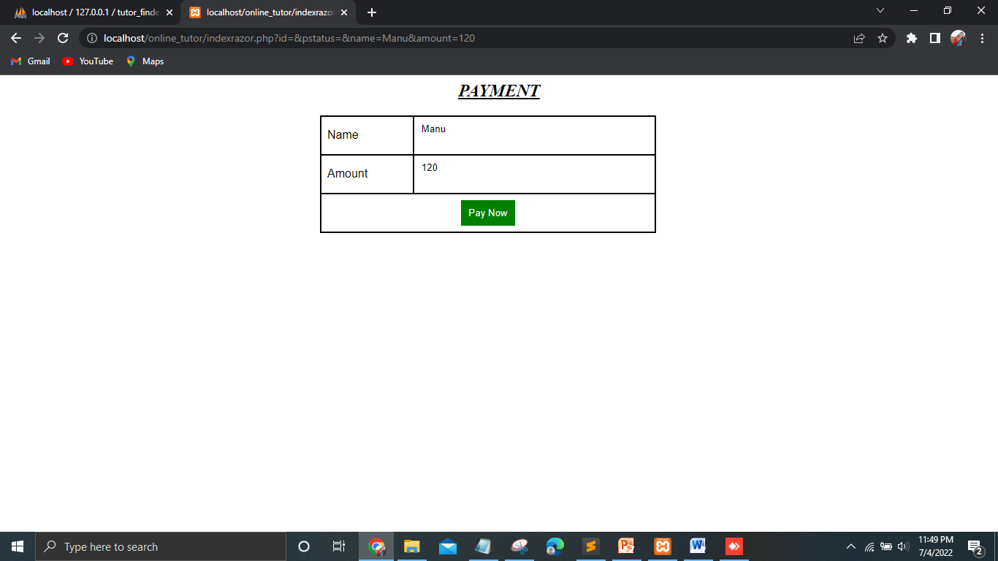
Form design
USER-PAYMENT PAGE

Slide 65
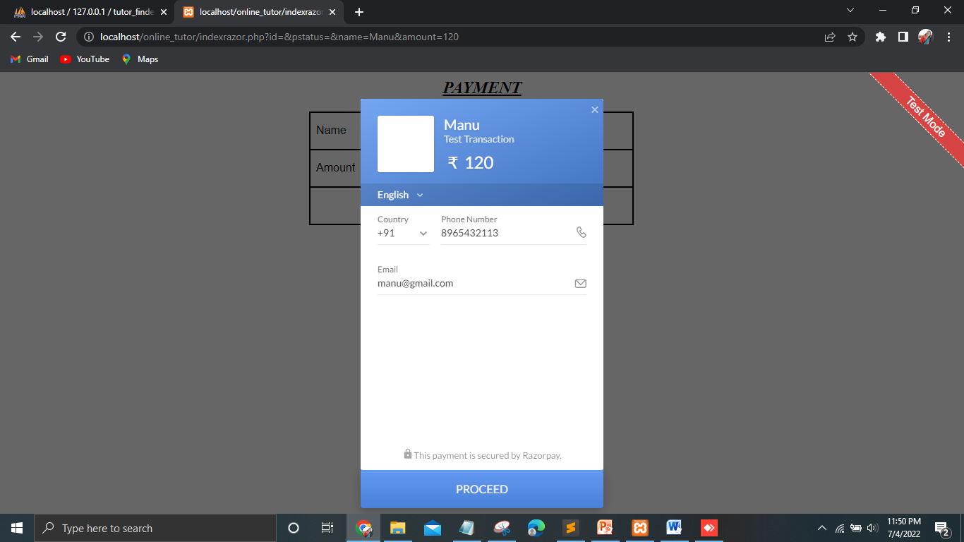
Form design
USER-PAYMENT PAGE

Slide 66
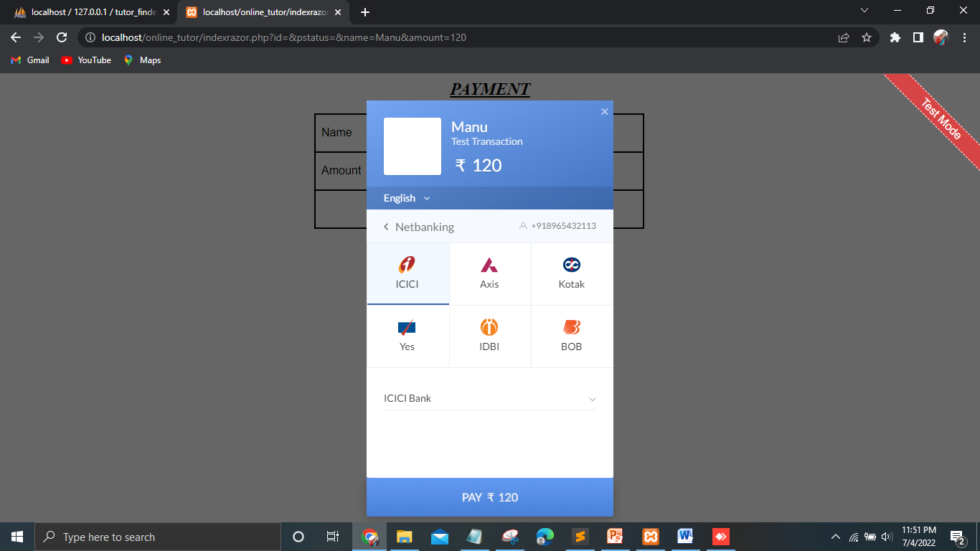
Form design
USER-PAYMENT PAGE

Slide 67
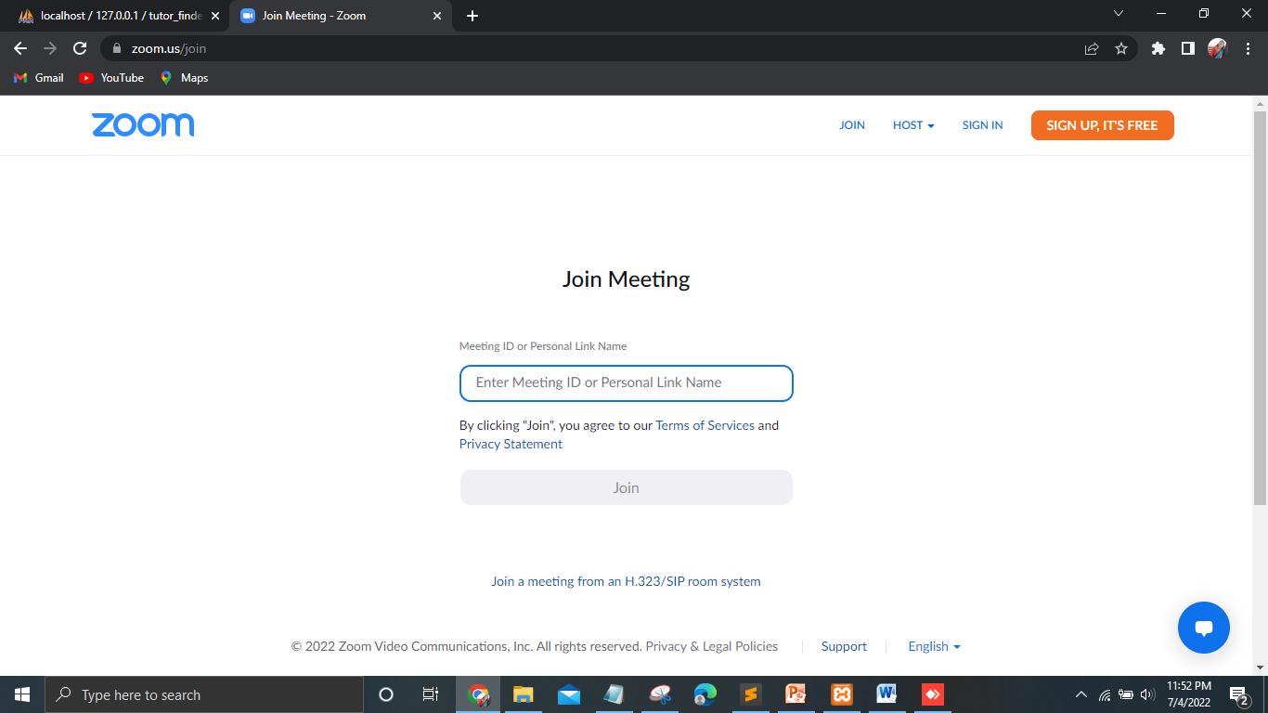
Form design
ONLINE CLASS

Slide 68
conclusion
Online tutoring system is one of the approaches used in today's private education which allows the tutors and students to communicate each other in a real time. The students agree the online learning give them a flexibility on their learning compared to traditional learning.

Slide 69
Thank you

